Slide 1
File Management
Chapter 12

Slide 2
File Management
File management system consists of system utility programs that run as privileged applications
Input to applications is by means of a file
Output is saved in a file for long-term storage

Slide 3
File System Properties
Long-term existence
Sharable between processes
Structure

Slide 4
File Operations
Create
Delete
Open
Close
Read
Write

Slide 5
Terms Used with Files
Field
  Basic element of data
  Contains a single value
  Characterized by its length and data type
Record
  Collection of related fields
  Treated as a unit
    Example: employee record

Slide 6
Terms Used with Files
File
  Collection of similar records
  Treated as a single entity
  Have file names
  May restrict access
Database
  Collection of related data
  Relationships exist among elements

Slide 7
Typical Operations
Retrieve_All
Retrieve_One
Retrieve_Next
Retrieve_Previous
Insert_One
Delete_One
Update_One
Retrieve_Few

Slide 8
File Management Systems
The way a user of application may access files
Programmer does not need to develop file management software

Slide 9
Objectives for a
File Management System
Meet the data management needs and requirements of the user
Guarantee that the data in the file are valid
Optimize performance
Provide I/O support for a variety of storage device types

Slide 10
Objectives for a
File Management System
Minimize or eliminate the potential for lost or destroyed data
Provide a standardized set of I/O interface routines
Provide I/O support for multiple users

Slide 11
Minimal Set of Requirements
Each user should be able to create, delete, read, write and modify files
Each user may have controlled access to other users’ files
Each user may control what type of accesses are allowed to the users’ files
Each user should be able to restructure the user’s files in a form appropriate to the problem

Slide 12
Minimal Set of Requirements
Each user should be able to move data between files
Each user should be able to back up and recover the user’s files in case of damage
Each user should be able to access the user’s files by using symbolic names

Slide 13
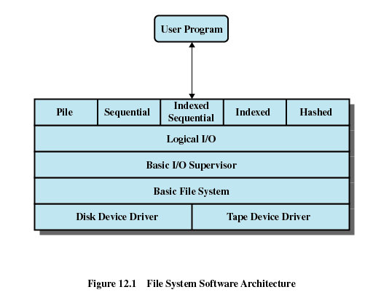

Slide 14
Device Drivers
Lowest level
Communicates directly with peripheral devices
Responsible for starting I/O operations on a device
Processes the completion of an I/O request

Slide 15
Basic File System
Physical I/O
Deals with exchanging blocks of data
Concerned with the placement of blocks
Concerned with buffering blocks in main memory

Slide 16
Basic I/O Supervisor
Responsible for file I/O initiation and termination
Control structures are maintained
Concerned with selection of the device on which file I/O is to be performed
Concerned with scheduling access to optimize performance
Part of the operating system

Slide 17
Logical I/O
Enables users and applications to access records
Provides general-purpose record I/O capability
Maintains basic data about file

Slide 18
Access Method
Reflect different file structures
Different ways to access and process data

Slide 19
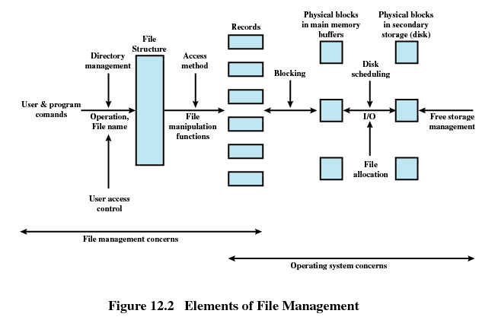

Slide 20
File Management Functions
Identify and locate a selected file
Use a directory to describe the location of all files plus their attributes
On a shared system describe user access control
Blocking for access to files
Allocate files to free blocks
Manage free storage for available blocks

Slide 21
Criteria for File Organization
Short access time
  Needed when accessing a single record
  Not needed for batch mode
Ease of update
  File on CD-ROM will not be updated, so this is not a concern

Slide 22
Criteria for File Organization
Economy of storage
  Should be minimum redundancy in the data
  Redundancy can be used to speed access such as an index
Simple maintenance
Reliability

Slide 23
File Organization
The Pile
  Data are collected in the order they arrive
  Purpose is to accumulate a mass of data and save it
  Records may have different fields
  No structure
  Record access is by exhaustive search

Slide 24
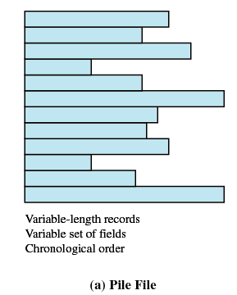
Pile

Slide 25
File Organization
The Sequential File
  Fixed format used for records
  Records are the same length
  All fields the same (order and length)
  Field names and lengths are attributes of the file
  One field is the key filed
    Uniquely identifies the record
    Records are stored in key sequence

Slide 26
File Organization
The Sequential File
  New records are placed in a log file or transaction file
  Batch update is performed to merge the log file with the master file

Slide 27
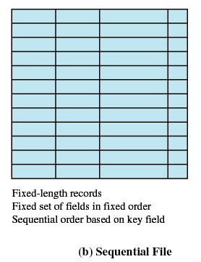
Sequential File

Slide 28
File Organization
Indexed Sequential File
  Index provides a lookup capability to quickly reach the vicinity of the desired record
    Contains key field and a pointer to the main file
    Indexed is searched to find highest key value that is equal to or precedes the desired key value
    Search continues in the main file at the location indicated by the pointer

Slide 29
File Organization
Comparison of sequential and indexed sequential
  Example: a file contains 1 million records
  On average 500,00 accesses are required to find a record in a sequential file
  If an index contains 1000 entries, it will take on average 500 accesses to find the key, followed by 500 accesses in the main file. Now on average it is 1000 accesses

Slide 30
File Organization
Indexed Sequential File
  New records are added to an overflow file
  Record in main file that precedes it is updated to contain a pointer to the new record
  The overflow is merged with the main file during a batch update
  Multiple indexes for the same key field can be set up to increase efficiency

Slide 31
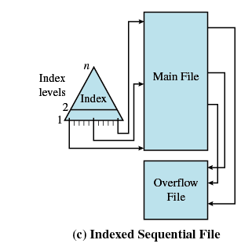
Indexed Sequential File

Slide 32
File Organization
Indexed File
  Uses multiple indexes for different key fields
  May contain an exhaustive index that contains one entry for every record in the main file
  May contain a partial index

Slide 33
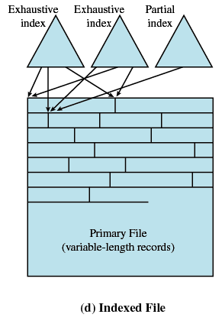
Indexed File

Slide 34
File Organization
The Direct or Hashed File
  Directly access a block at a known address
  Key field required for each record

Slide 35
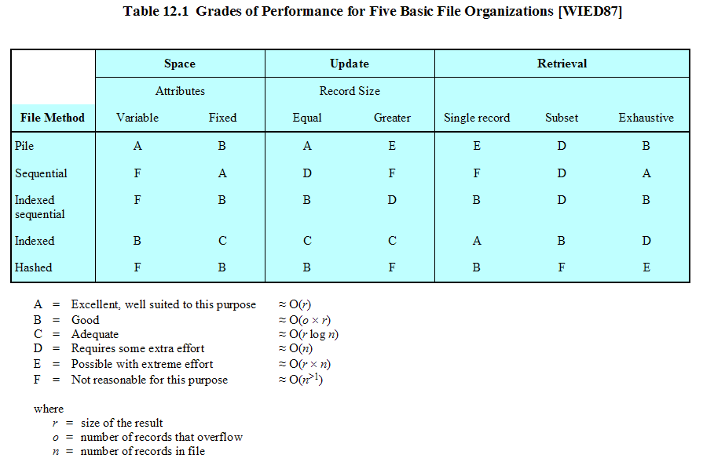

Slide 36
File Directories
Contains information about files
  Attributes
  Location
  Ownership
Directory itself is a file owned by the operating system
Provides mapping between file names and the files themselves

Slide 37
Simple Structure for a Directory
List of entries, one for each file
Sequential file with the name of the file serving as the key
Provides no help in organizing the files
Forces user to be careful not to use the same name for two different files

Slide 38

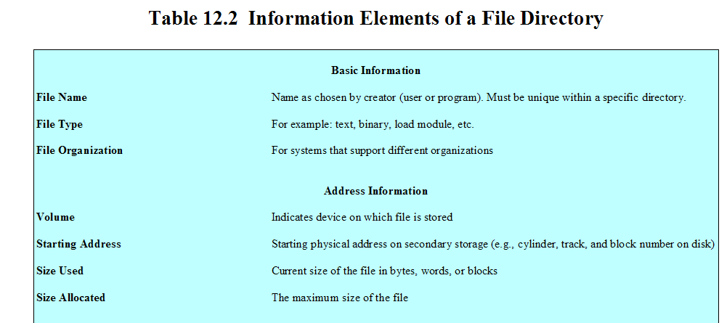

Slide 39
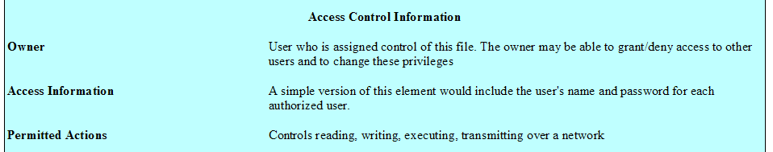

Slide 40
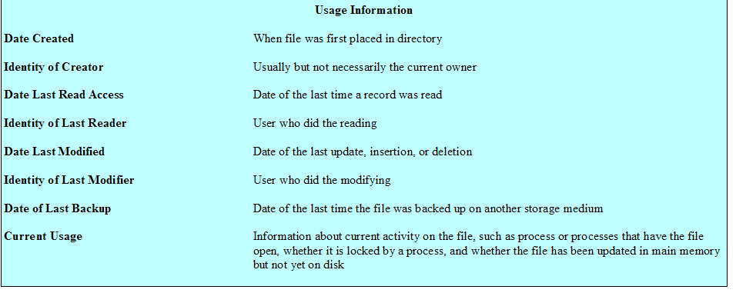

Slide 41
Two-level Scheme for a Directory
One directory for each user and a master directory
Master directory contains entry for each user
  Provides address and access control information
Each user directory is a simple list of files for that user
Still provides no help in structuring collections of files

Slide 42
Hierarchical, or Tree-Structured Directory
Master directory with user directories underneath it
Each user directory may have subdirectories and files as entries

Slide 43
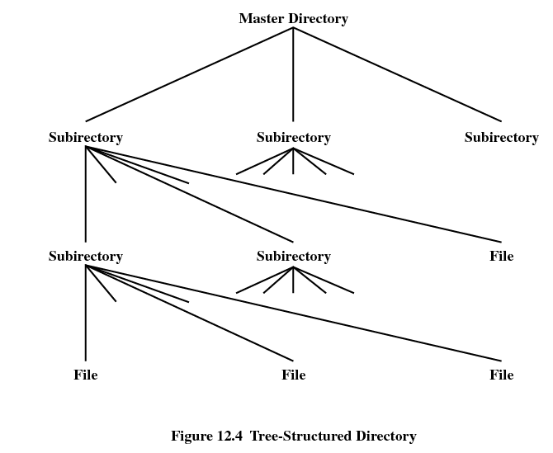

Slide 44
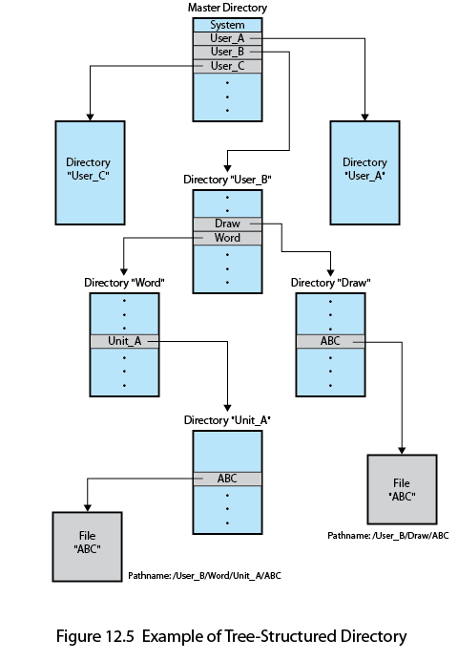

Slide 45
Hierarchical, or Tree-Structured Directory
Files can be located by following a path from the root, or master, directory down various branches
  This is the pathname for the file
Can have several files with the same file name as long as they have unique path names

Slide 46
Hierarchical, or Tree-Structured Directory
Current directory is the working directory
Files are referenced relative to the working directory

Slide 47
File Sharing
In multiuser system, allow files to be shared among users
Two issues
  Access rights
  Management of simultaneous access

Slide 48
Access Rights
None
  User may not know of the existence of the file
  User is not allowed to read the user directory that includes the file
Knowledge
  User can only determine that the file exists and who its owner is

Slide 49
Access Rights
Execution
  The user can load and execute a program but cannot copy it
Reading
  The user can read the file for any purpose, including copying and execution
Appending
  The user can add data to the file but cannot modify or delete any of the file’s contents

Slide 50
Access Rights
Updating
  The user can modify, deleted, and add to the file’s data. This includes creating the file, rewriting it, and removing all or part of the data
Changing protection
  User can change access rights granted to other users
Deletion
  User can delete the file

Slide 51
Access Rights
Owners
  Has all rights previously listed
  May grant rights to others using the following classes of users
    Specific user
    User groups
    All for public files

Slide 52
Simultaneous Access
User may lock entire file when it is to be updated
User may lock the individual records during the update
Mutual exclusion and deadlock are issues for shared access

Slide 53
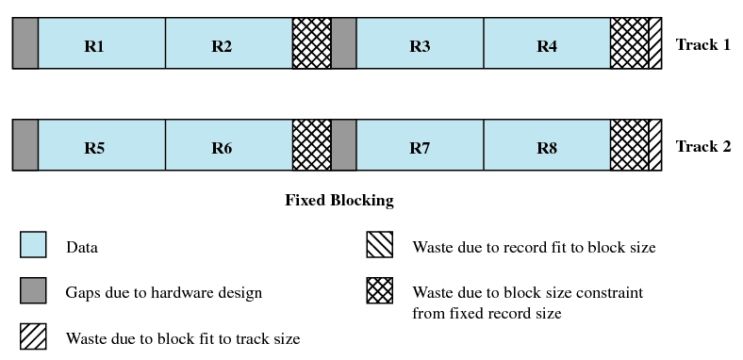
Fixed Blocking

Slide 54
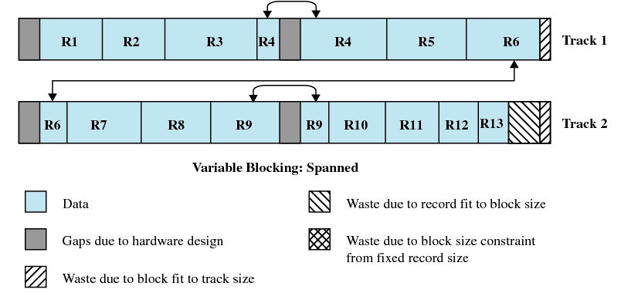
Variable Blocking: Spanned

Slide 55
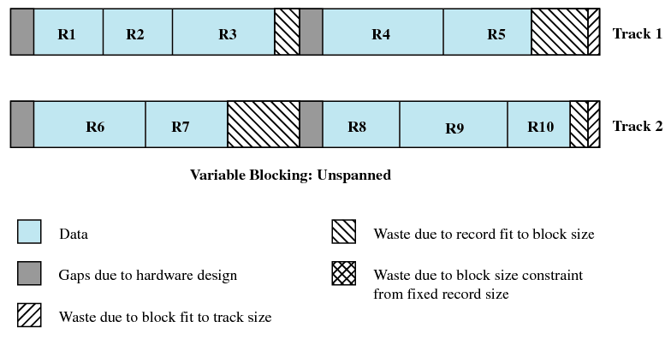
Variable Blocking Unspanned

Slide 56
Secondary Storage Management
Space must be allocated to files
Must keep track of the space available for allocation

Slide 57
Preallocation
Need the maximum size for the file at the time of creation
Difficult to reliably estimate the maximum potential size of the file
Tend to overestimated file size so as not to run out of space

Slide 58
Methods of File Allocation
Contiguous allocation
  Single set of blocks is allocated to a file at the time of creation
  Only a single entry in the file allocation table
    Starting block and length of the file
External fragmentation will occur
  Need to perform compaction

Slide 59


Slide 60
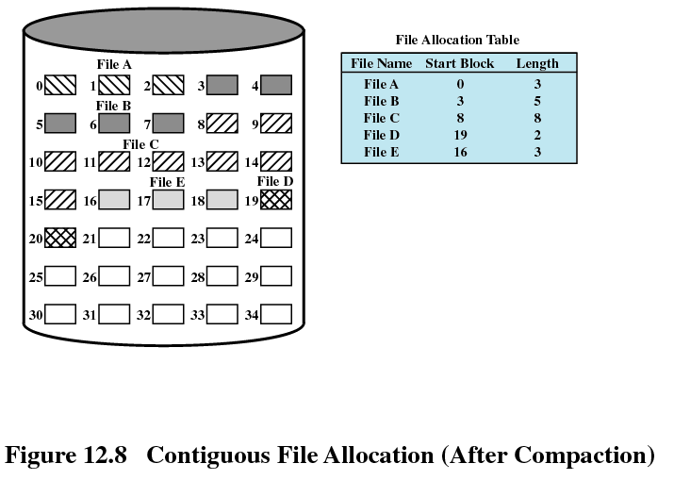

Slide 61
Methods of File Allocation
Chained allocation
  Allocation on basis of individual block
  Each block contains a pointer to the next block in the chain
  Only single entry in the file allocation table
    Starting block and length of file
No external fragmentation
Best for sequential files
No accommodation of the principle of locality

Slide 62
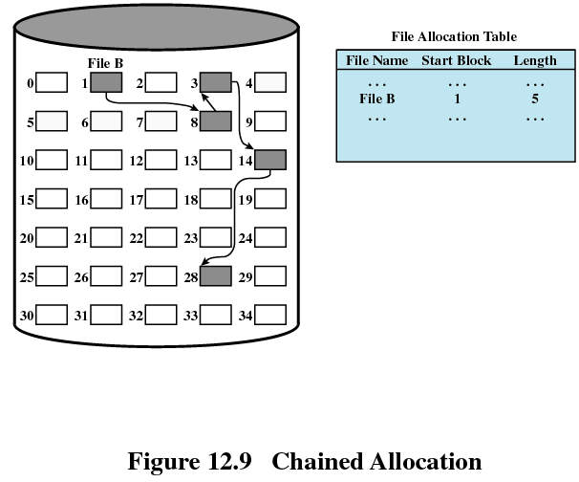

Slide 63
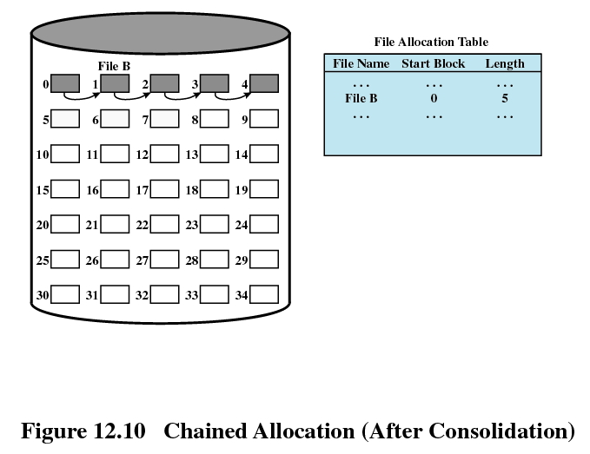

Slide 64
Methods of File Allocation
Indexed allocation
  File allocation table contains a separate one-level index for each file
  The index has one entry for each portion allocated to the file
  The file allocation table contains block number for the index

Slide 65
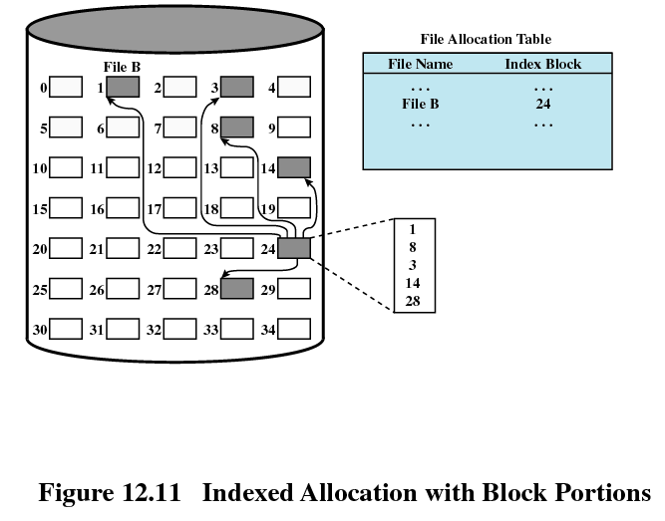

Slide 66
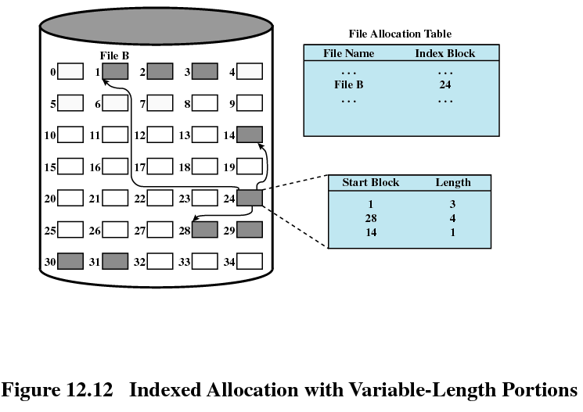

Slide 67
UNIX File Management
Types of files
  Regular, or ordinary
  Directory
  Special
  Named pipes
  Links
  Symbolic links

Slide 68
Inodes
Index node
Control structure that contains key information for a particular file

Slide 69
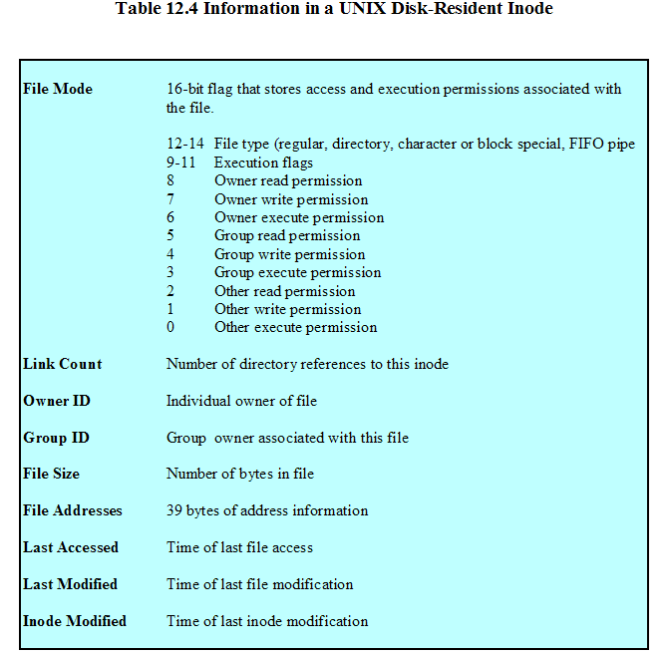

Slide 70
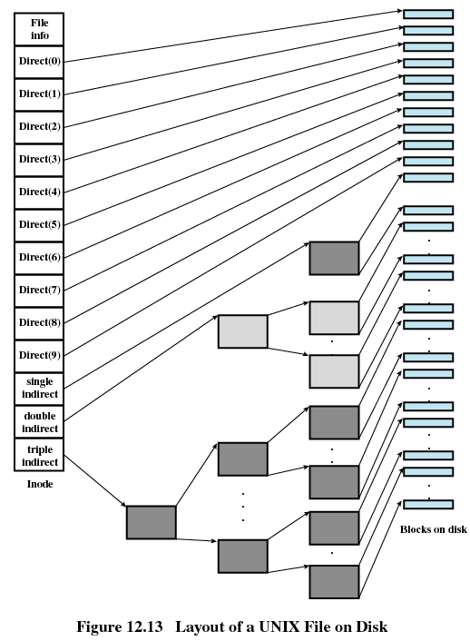

Slide 71
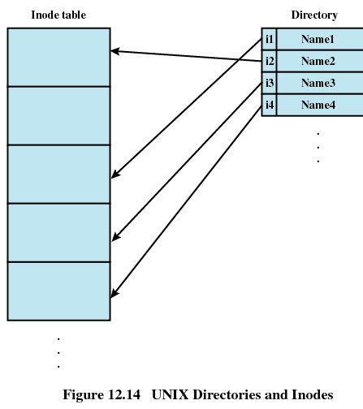

Slide 72
Linux Virtual File System
Uniform file system interface to user processes
Represents any conceivable file system’s general feature and behavior
Assumes files are objects that share basic properties regardless of the target file system

Slide 73
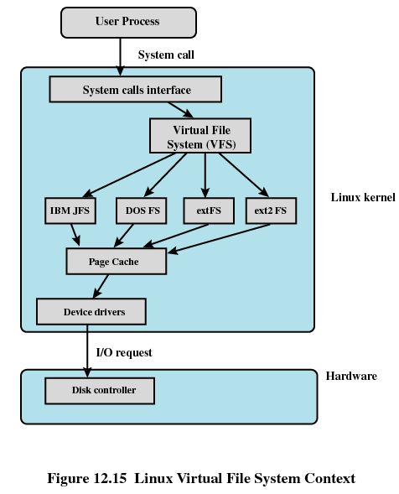

Slide 74
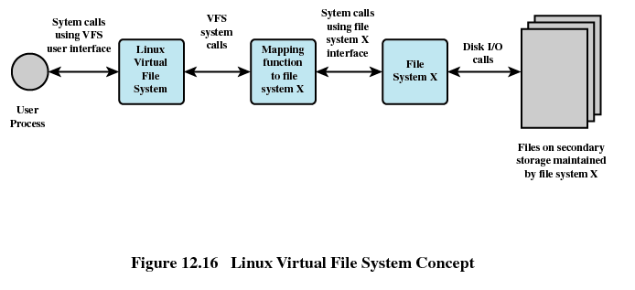

Slide 75
Primary Objects in VFS
Superblock object
  Represents a specific mounted file system
Inode object
  Represents a specific file
Dentry object
  Represents a specific directory entry
File object
  Represents an open file associated with a process

Slide 76
Windows File System
Key features of NTFS
  Recoverability
  Security
  Large disks and large files
  Multiple data streams
  General indexing facility

Slide 77
NTFS Volume and File Structure
Sector
  The smallest physical storage unit on the disk
Cluster
  One or more contiguous sectors
Volume
  Logical partition on a disk

Slide 78
